Slide 1




Slide 2
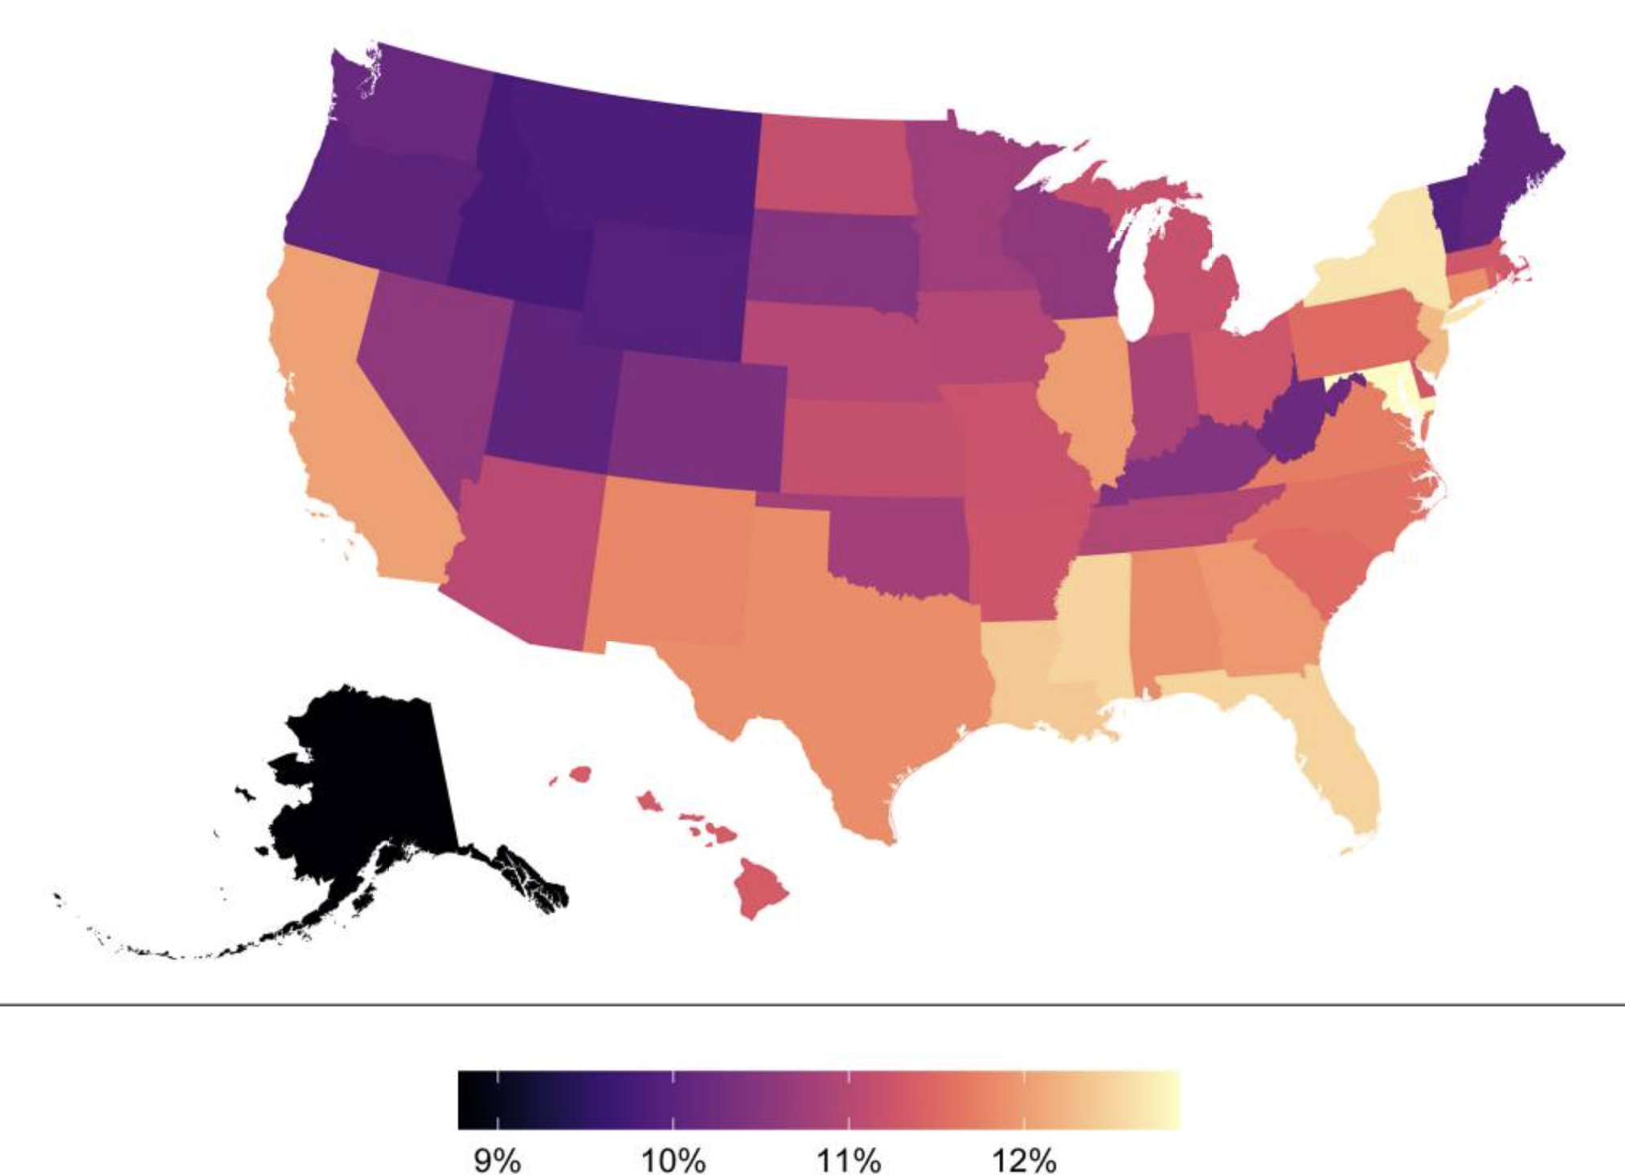
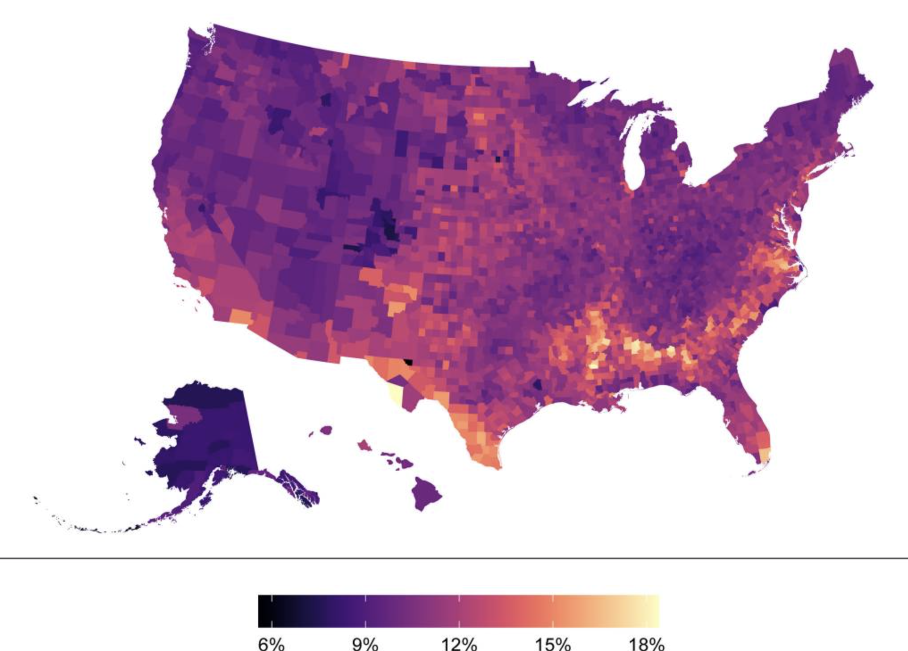
Prevalence of Alzheimer’s dementia
(a) States
(b) Counties

Slide 3
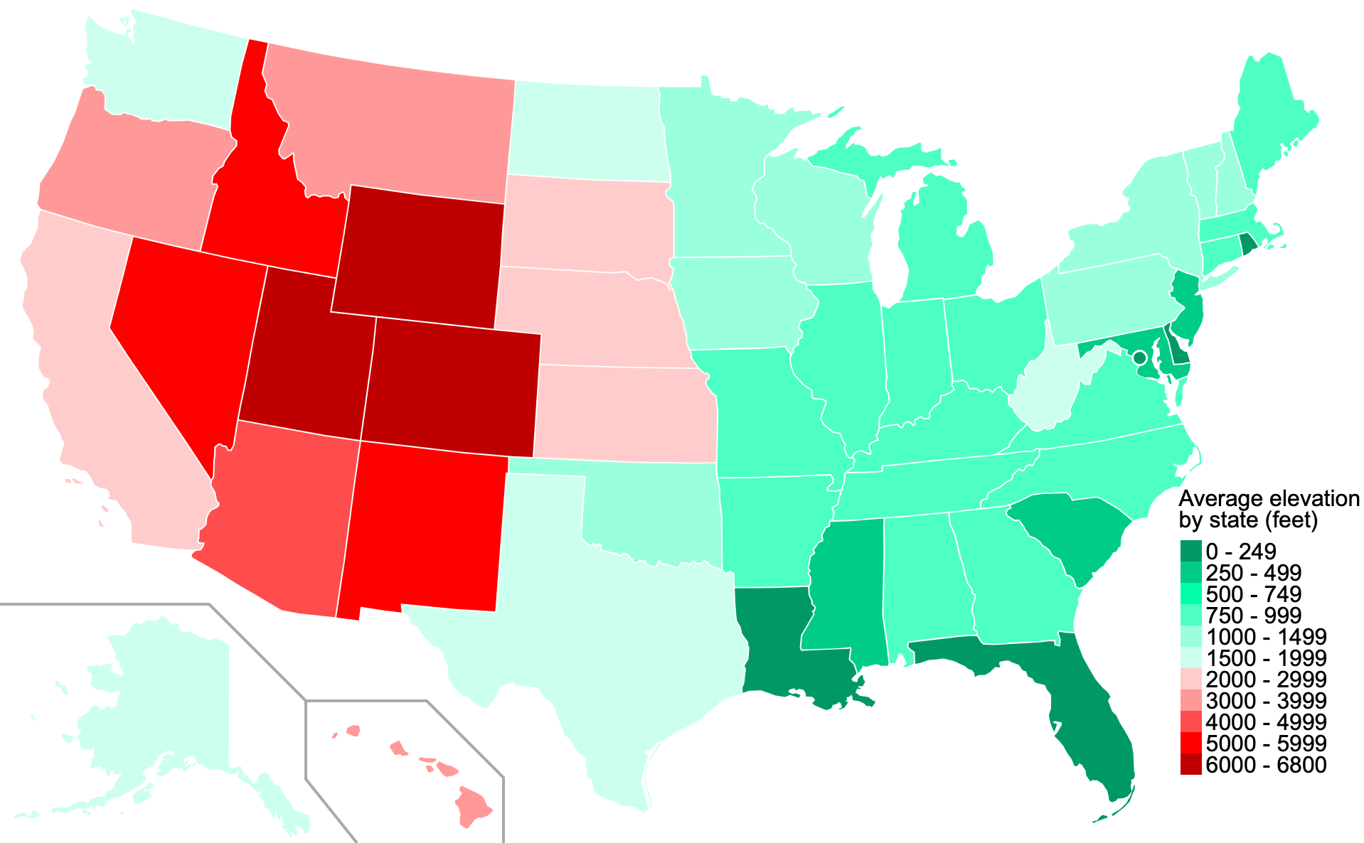
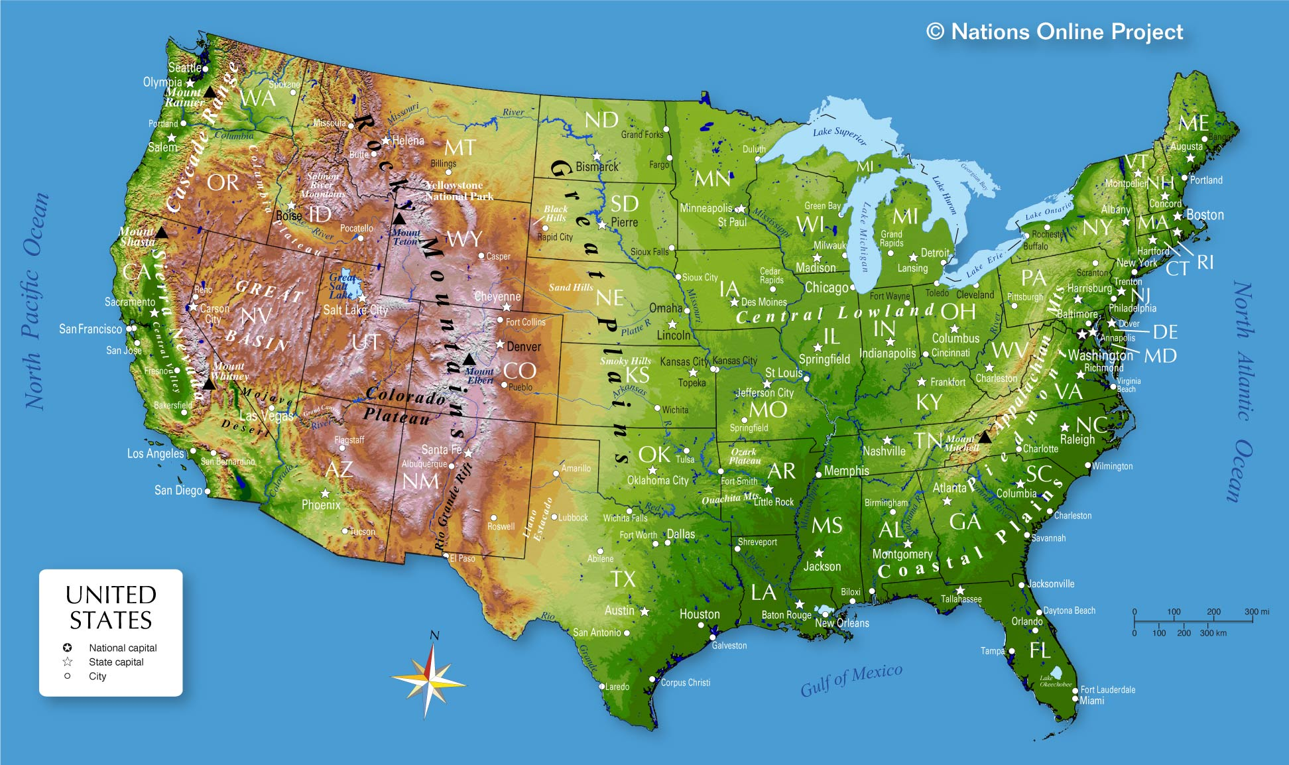
By Crossover1370 - Own work, derived from File:Blank US Map (states only).svg. Data sourced from Statista., CC BY-SA 4.0, https://commons.wikimedia.org/w/index.php?curid=122689931
Topographic map of the United States.
https://en.wikipedia.org/wiki/Geography_of_the_United_States
CC BY-SA 3.0, https://commons.wikimedia.org/w/index.php?curid=1337120
https://en.wikipedia.org/wiki/List_of_U.S._states_and_territories_by_elevation
https://simple.wikipedia.org/wiki/List_of_U.S._states_by_elevation

